Slide 1


Green Pace
Security Policy Presentation
Developer: Coral Stewart
A dive into security principles and standards for Green Pace’s security guide

Slide 2

OVERVIEW: DEFENSE IN DEPTH
This security policy includes robust and secure coding standards as well as important security principles. Utilizing both C and C++ coding standards, this policy provides multiple layers to ensure code is closely aligned with secure coding practices while maintaining efficiency and reliability. This guide is easy to digest and should be used consistently.

Slide 3
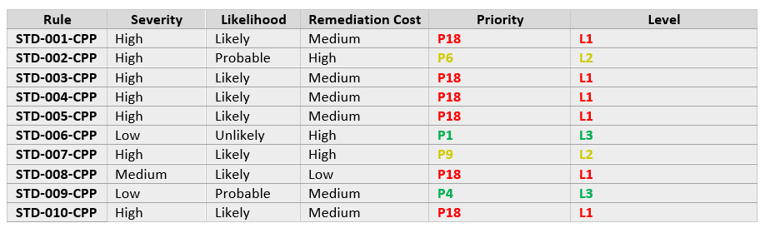
THREATS MATRIX
The risks with high likelihood and priority include do not declare or define a reserved identifier, do not attempt to create a std::string from a null pointer, exclude user input from format strings, do not access freed memory, ensure your random number generator is properly seeded, and detect and handle memory allocation errors. Probable and unlikely with mid to low-level priorities include do not access an object outside of its lifetime, incorporate diagnostic tests using assertions, guarantee exception safety, and do not abruptly terminate the program. All of these are important, especially the 6 high priority threats as they directly violate multiple security principles each.

Slide 4
10 PRINCIPLES
Validate Input Data
Do not access an object outside of its lifetime
Do not attempt to create a std::string from a null pointer
Exclude user input from format strings
Heed Compiler Warnings
Incorporate diagnostic tests using assertions
Architect and Design for Security Policies
Do not declare or define a reserved identifier
Guarantee exception safety
Keep it Simple
Ensure your random number generator is properly seeded
Default Deny
Do not abruptly terminate the program
Adhere to the Principle of Least Privilege
Guarantee exception safety
Do not abruptly terminate the program
Sanitize Data Sent to Other Systems
Exclude user input from format strings
Practice Defense in Depth
Do not access an object outside of its lifetime
Do not access freed memory
Detect and handle memory allocation errors
Use Effective Quality Assurance Techniques
Do not attempt to create a std::string from a null pointer
Do not access freed memory
Incorporate diagnostic tests using assertions
Detect and handle memory allocation errors
Adopt a Secure Coding Standard
Do not declare or define a reserved identifier
Ensure your random number generator is properly seeded

Slide 5
CODING STANDARDS
1. Do not declare or define a reserved identifier
2. Do not attempt to create a std::string from a null pointer
3. Exclude user input from format strings
4. Do not access freed memory
5. Ensure your random number generator is properly seeded
6. Detect and handle memory allocation errors
7. Guarantee exception safety
8. Do not access an object outside of its lifetime
9. Do not abruptly terminate the program
10. Incorporate diagnostic tests using assertions
I ranked these as such because the first 6 standards are all high severity, likely, and high priority. I ranked them according to these characteristics and those that follow the first 6 are low and medium severity, probably or unlikely, with moderate to low priorities.

Slide 6
ENCRYPTION POLICIES
Encryption at rest
Encryption at rest refers to the protection of data that is not actively moving between devices and is typically kept on hard drives or in databases. Data at rest should be encrypted because it is the most valuable type of data for hackers. This mitigates data breach risks resulting from theft of the device or access to databases.
Encryption in flight
Encryption in flight refers to the protection of data that is actively traveling between devices and is typically in the form of emails, communication channels, collaborative tools and instant messaging. This type of data is still vulnerable to interception or tampering during transmission. With TLS/SSL, interception can be prevented. It is extremely important for credentials and confidential data to be safeguarding when being transmitted over networks.
Encryption in use
Encryption in use refers to the protection of data that is actively being processed and accessed by users or software. Data in this format is immediately accessible, which makes it vulnerable. It is important to protect data of this type because it is the most vulnerable, especially when being used by highly secure environments (financial institutions, medical platforms, government systems).

Slide 7
TRIPLE-A POLICIES
Authentication
Authentication refers to the process of verifying a user’s identity prior to access being granted. Using MFA and biometrics are two examples of strong authentication methods. This ensures only appropriate users can access sensitive systems and is crucial to preventing any unauthorized access and potential spoofing.
Authorization
Authorization refers to the specific actions an authenticated user is allowed to perform. This applies to the principle of least privilege, which ensures users only have access to the resources absolutely necessary for their role and given tasks. Authorization prevents system abuse and privilege escalation, which can result in data leakage.
Accounting
Accounting refers to the continuous monitoring and logging of user activities and system access. This enforces compliance and also allows for the tracking and detection of anomalies and incidents. Accounting supports accountability.

Slide 8
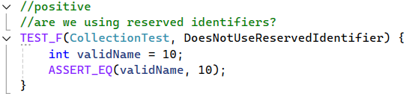
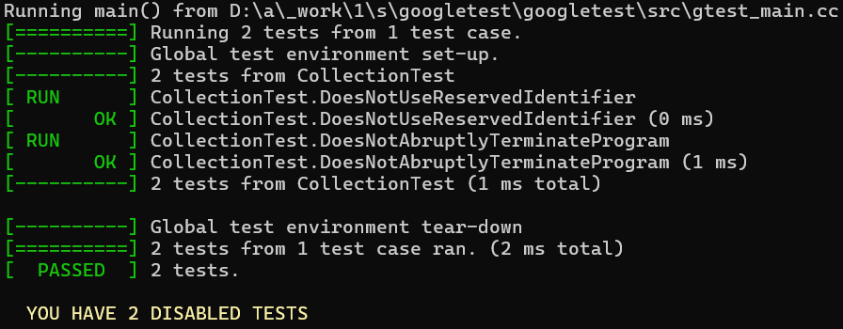
Are we using reserved identifiers?
1. Do not declare or define a reserved identifier
We can take this testing further by running a static analysis tool to automatically detect reserved identifiers

Slide 9
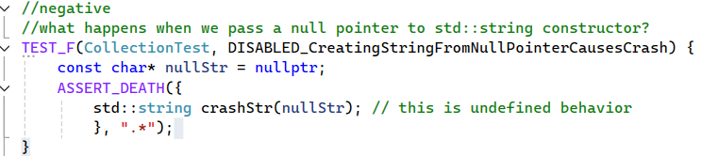
What happens when we pass a null pointer to std::string constructor?
2. Do not attempt to create a std::string from a null pointer
We can catch unidentified behavior early by using sanitizers during testing

Slide 10
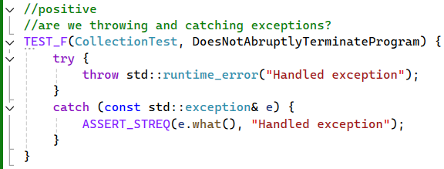
Are we throwing and catching exceptions?
9. Do not abruptly terminate the program
We can make sure logging and cleanup is done during exception handling

Slide 11
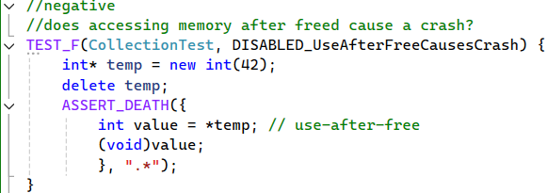
Does accessing memory after freed cause a crash?
8. Do not access an object outside of its lifetime
We can integrate debugging tools for automatic memory management

Slide 12

AUTOMATION SUMMARY
Automation should be a strong component to multiple stages of the DevOps process. During the Build and Verify and Test stages, the code should be scanned for coding standard violations and quality issues. Automation can enforce security configurations during the Transition and health check stage. I also feel as though automation could benefit this process in the Continuous monitoring stage by using log analysis and automated alerting when policy violations or intrusions are found with SIEM tools. Implementing automation at these stages will ensure continuous monitoring and compliance.

Slide 13
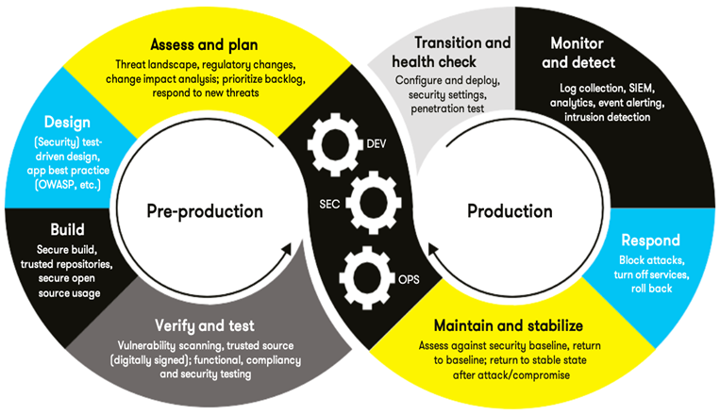
TOOLS
The DevSecOps pipeline embeds security practices throughout the software development lifecycle. From coding to development, security testing and automation are integrated at every step.
OWASP provides resources, tools and frameworks to help developers mitigate security vulnerabilities. This is used during pre-production at the Design stage.
Tools such as static and dynamic application security testing and software composition analysis are utilized throughout multiple DevSecOps stages (Yuga, 2024).
Overall, DevSecOps utilizes numerous security and automated tool throughout the entire SDLC, which makes it a top runner for automated workflows.

Slide 14
RISKS AND BENEFITS
Security should always be a company’s #1 priority when it comes to software. Whether data is private, proprietary, sensitive, it should be protected and that is what DevSecOps and this security guide are aiming to accomplish. Rather than waiting until the end of the SDLC to implement secure practices, DevSecOps offers continuous integration and delivery (CI/CD), so that security is #1 at every stage of the SDLC. Putting this off and waiting could mean risking the attacks from malicious users, unintended behavior, and crashes. Every moment you wait can create an opening for an attack, and it is important to not be complacent when security is on the line. Opting to implement DevSecOps may affect scaling, tool integration and even the culture of the company, but this can be addressed by stressing the value and importance of integrated security and implementing scalable security tools. Choosing tools that are compatible and flow effortlessly with the tech stack can overcome any tool integration issues as well (Yuga, 2024).

Slide 15
RECOMMENDATIONS
Lack of SEI CERT C++ coverage
Although 10 standards were pulled out of the SEI CERT C++ library, not all areas were covered. All 10 security principles should be enforced utilizing these standards.
Not enough automated security testing
Implement more input validation
Weak CI/CD integration
Use security tools with every pull request
Limited training
Conduct regular, quarterly training on secure coding and the DevSecOps pipeline

Slide 16
CONCLUSIONS
SEI CERT C/C++ Secure Coding Standards
OWASP SAMM
NIST SSDF
ISO/IEC
SBOM
By implementing these standards, you can effectively address code injection, vulnerable third-party libraries, supply chain risks, weak development, and race conditions

Slide 17
REFERENCES
Yuga. (2024, June 24). What is DevSecOps pipelines? - comprehensive guide. Practical DevSecOps. https://www.practical-devsecops.com/what-is-devsecops-pipelines/

